Slide 1
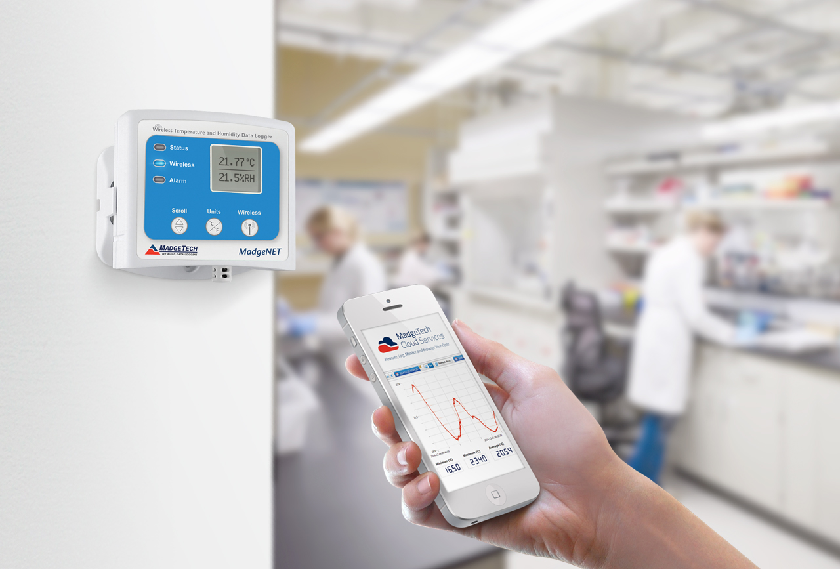

Wireless Data Logger Monitoring Systems

Slide 2
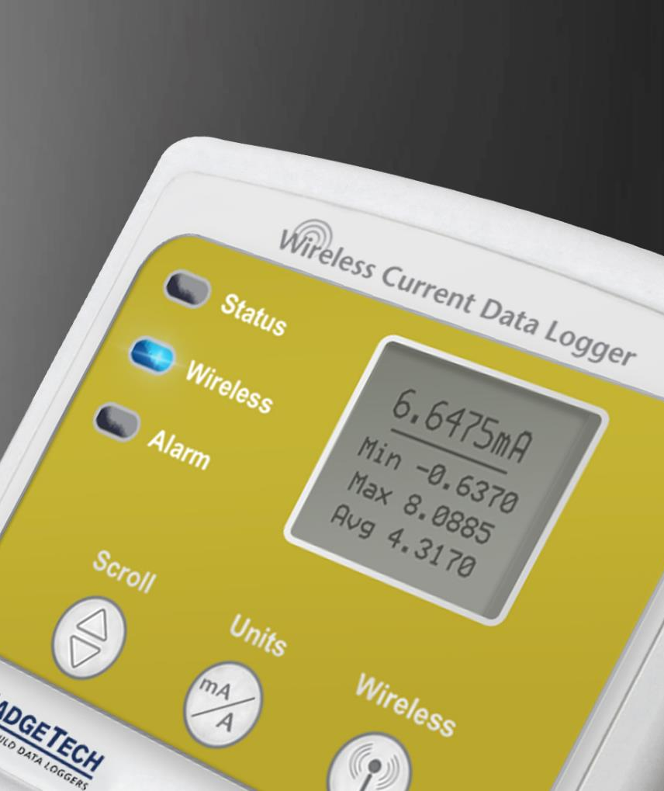

Table of Contents
About MadgeTech, Inc.
Wireless Systems & Components
Wireless Data Loggers
2000A Wireless Data Logger Models
MadgeTech Cloud Services
MadgeTech 4 Data Logger Software
Servicing and Maintenance
MadgeTech Customer Support

Slide 3

About MadgeTech
MadgeTech, Inc. is a global company based in New England and founded on traditional principles, customer service, quality and trust.
MadgeTech designs, engineers and manufactures all products at the USA headquarters, and distributes around the globe.
MadgeTech is dedicated to providing reliable, cutting edge products at an affordable price with world class customer service.

Slide 4
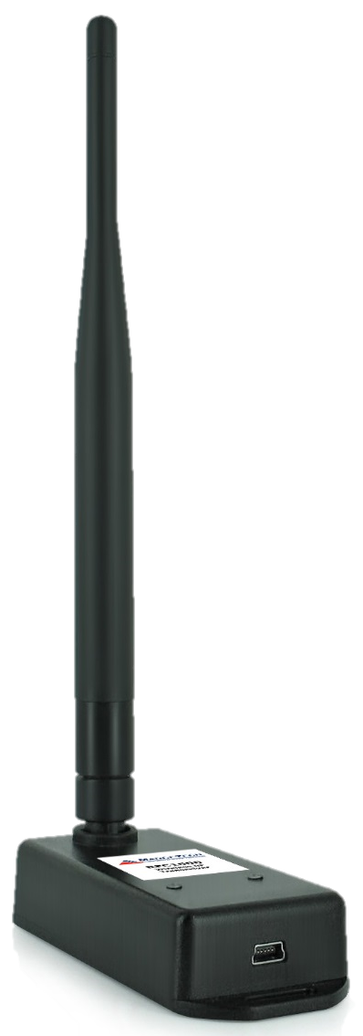
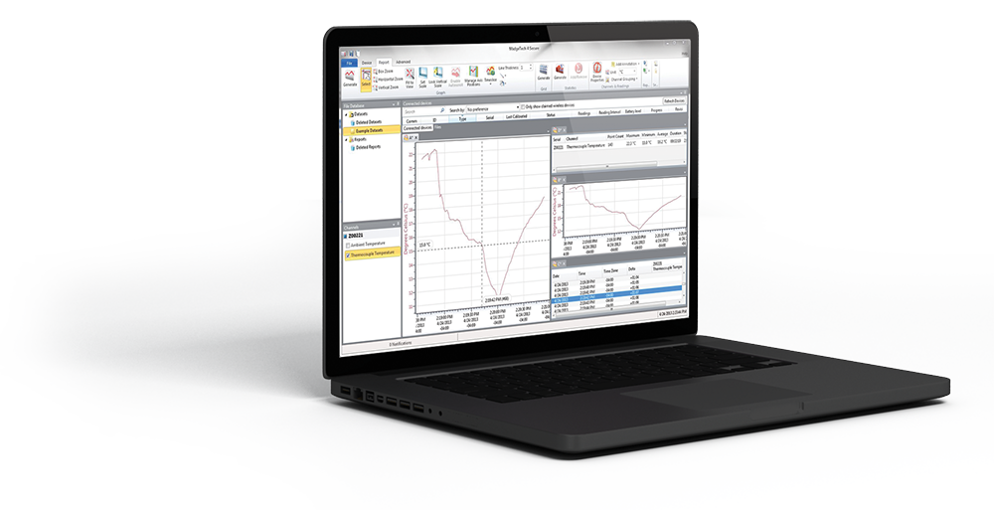
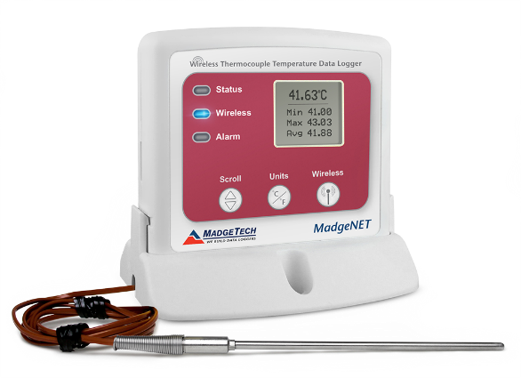
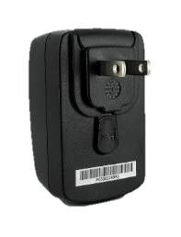
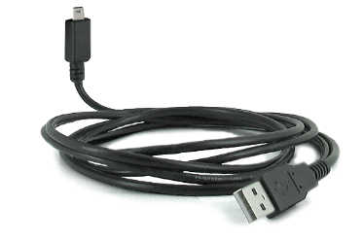
Wireless Systems & Components
Building your Data Logging System
A Data Logger
MadgeTech Software
Transceiver & USB Cable
RFTCTemp2000A
Wireless Thermocouple
Temperature Data Logger
MadgeTech 4 Software
Free Standard Software available or Secure Software available for purchase
RFC1000 Wireless Transceiver
With USB Cable & Power Adapter

Slide 5
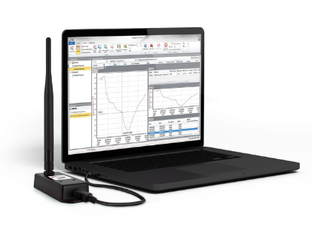
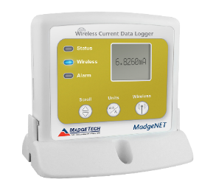
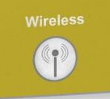
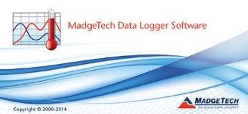
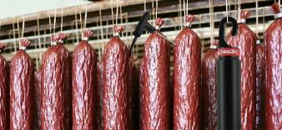
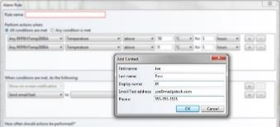
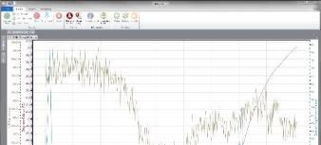
Wireless Network Setup
Software Installation & Data Logger Activation
1. Install
2. Connect
3 Activate
Connect one RFC1000 transceiver to the main PC.
(Additional RFC1000’s may be
used throughout the facility if needed to extend range.)
Activate the wireless feature on the data logger by pressing down on the Wireless button for 5 seconds. (RF2000A models)
Install the MadgeTech 4 Software and USB Drivers.
4 Deploy
5 Configure
6 Data Transfer
Data loggers are deployed
as needed throughout
the facility.
Data Loggers can be connected, configured and operated simultaneously
Real time data is instantly transmitted back to the PC. Wireless text message & email alerts can be automated with alarm settings.

Slide 6
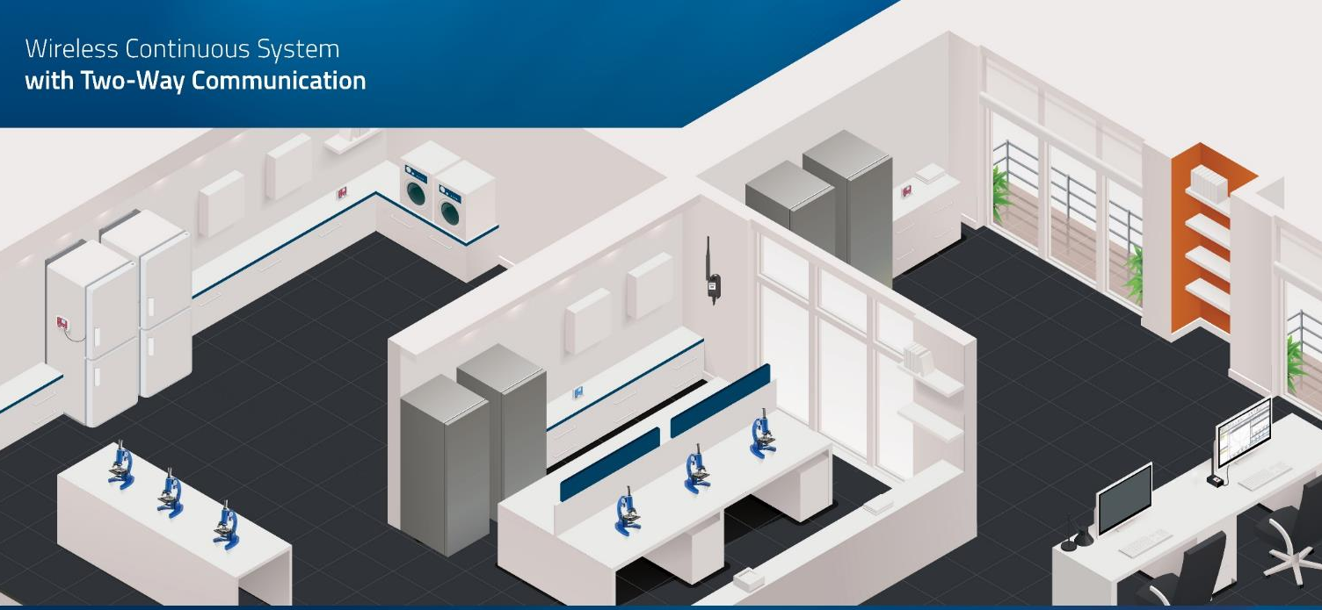
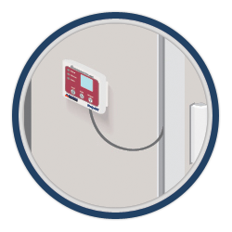
Wireless Network Diagram
Data Logger Communication throughout your Facility
Main PC

Slide 7

Wireless Data Loggers

Slide 8
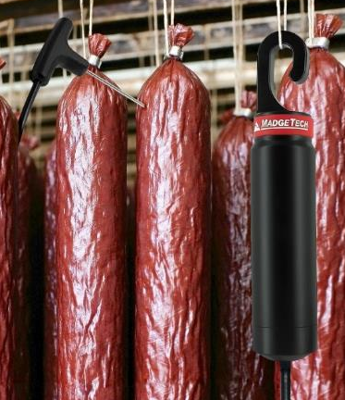
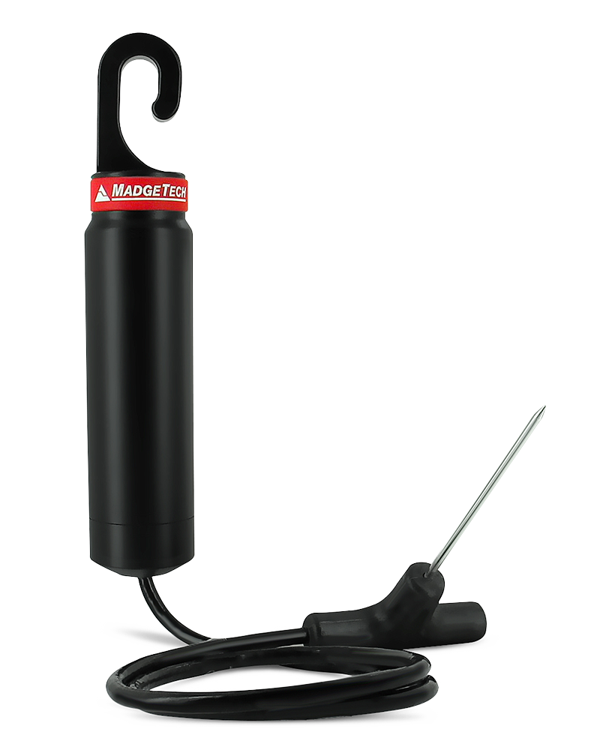
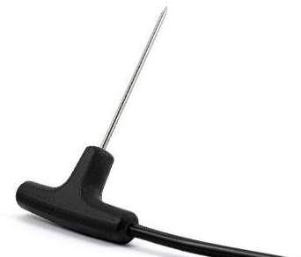
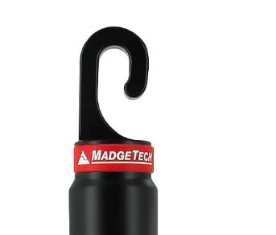
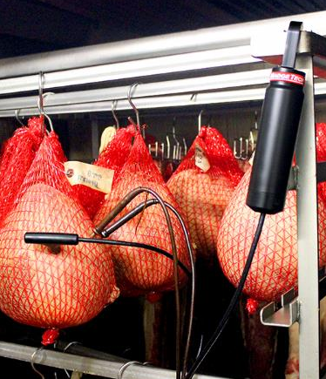
RFOT Wireless Data Logger
Wireless Meat Temperature Monitoring
RFOT
Wireless Meat Temperature Data Logger with Two-Way Communication
*Note: The RFOT needs to be mounted in a vertical position by the hook to communicate with the interface cable correctly.

Slide 9
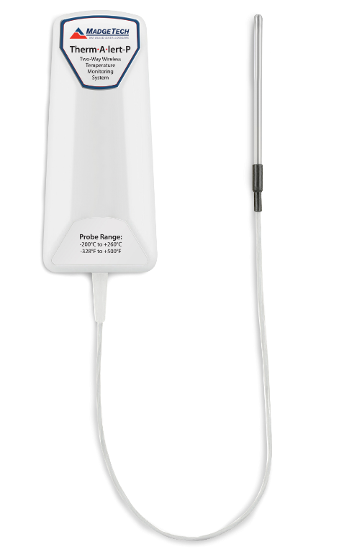
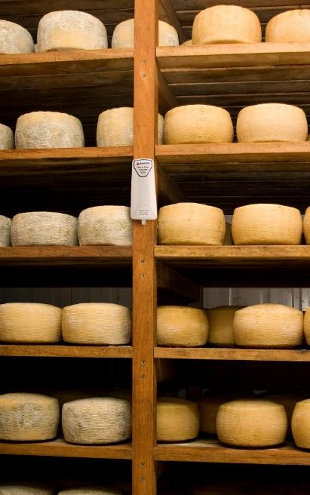
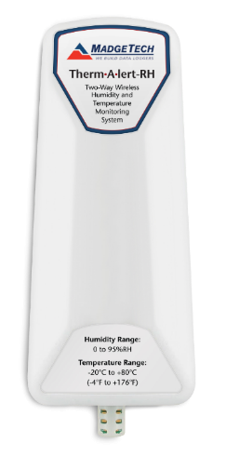
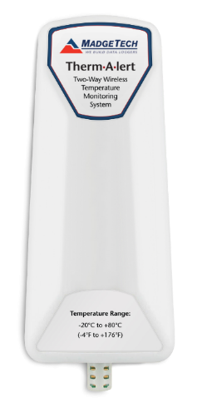
Therm•A•Lert Wireless Series
Precision Wireless Data Loggers
Therm•A•Lert-P
Precision Wireless Temperature Data Logger with external probe
Therm•A•Lert-RH
Precision Wireless
Humidity & Temperature
Data Logger
Therm•A•Lert
Precision Wireless
Temperature
Data Logger
*Note: The Therm•A•Lert’s need to be
mounted in a vertical position to
communicate with the interface cable correctly.

Slide 10
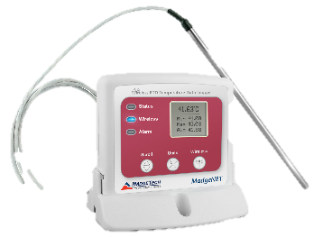
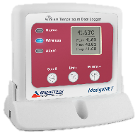
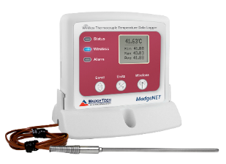
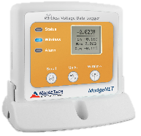
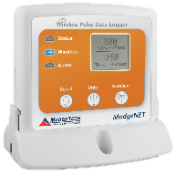
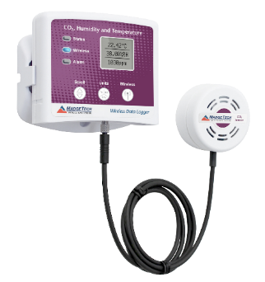
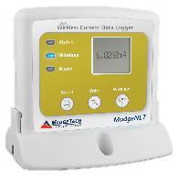
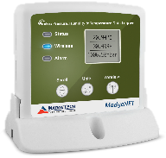
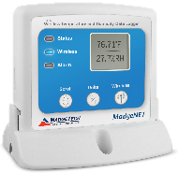
2000A Wireless Series
Designed for a Variety of Applications
RFTemp2000A
Wireless Ambient Temperature Data Logger with LCD Display
RFTCTemp2000A
Wireless Thermocouple Data Logger with
LCD Display
RFRTDTemp2000A
Wireless Precision RTD Data Logger
with LCD Display
RFVolt2000A
Wireless Voltage Data Logger with LCD Display
RFPulse2000A
Wireless Pulse Data Logger with LCD Display
RFCurrent2000A
Wireless DC Current
Data Logger with LCD Display
RFPRHTemp2000A
Wireless Pressure, Humidity & Temperature Data Logger with LCD Display
RFRHTemp2000A
Wireless Humidity & Temperature Data Logger with LCD Display
RFCO2RHTemp2000A
Wireless CO2, Humidity & Temperature Data Logger with LCD Display

Slide 11
2000A Wireless Data Logger Models

Slide 12
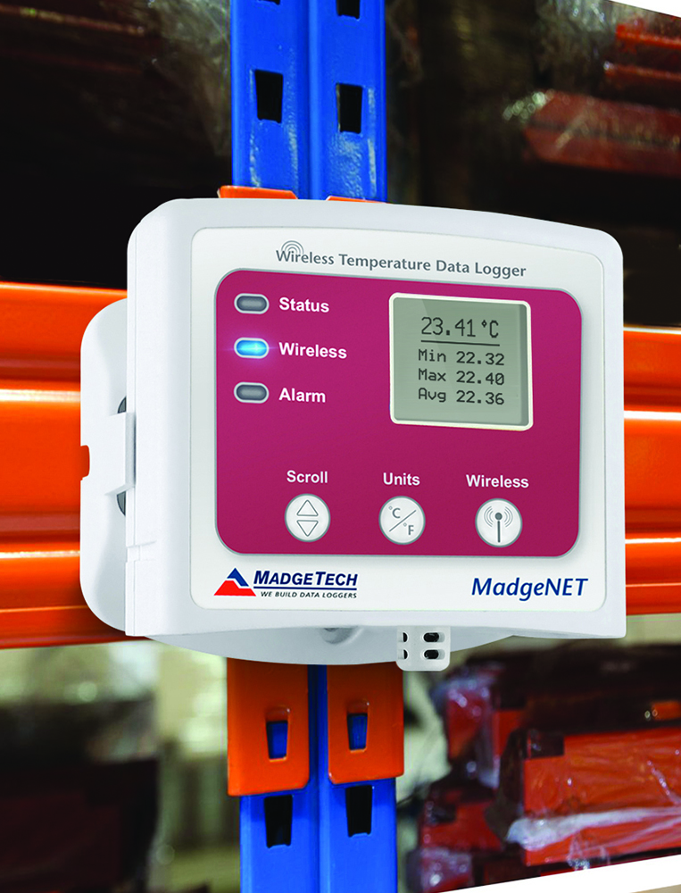
2000A Series Common Features
Wireless Data Loggers
Stand Alone Data Logger with Wireless Capability
Direct USB Interface when used in stand alone mode
Bracket for Wall Mounting or Stand:
  Dimensions: 3.5 in x 3.25 in 0.95 in
  (88.9 mm x 82.6 mm x 24.1 mm)
Audible Alarms
Digital Readout via LCD
  Battery Life Indicator
  Current Reading
  Minimum, Maximum, Average Statistics
Reset Statistics using Keypad
Long Battery Life
External power option available
  Battery will be used as backup

Slide 13
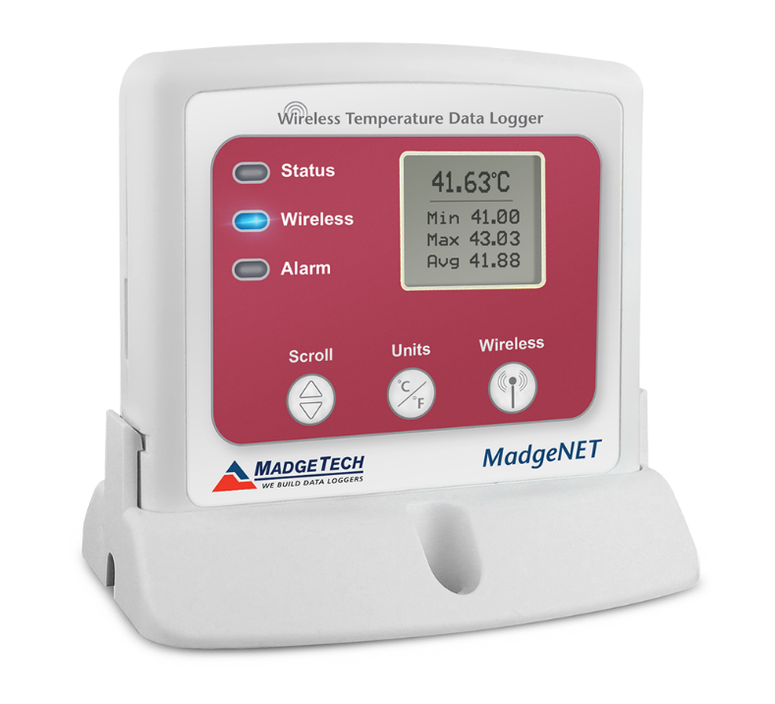

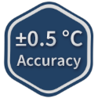

RFTemp2000A
Wireless Ambient Temperature Monitoring
Features & Benefits
Ideal for Ambient Temperature Monitoring:
  Measurement Range:
  -20 °C to +60 °C (-4 °F to +140 °F)
Bracket for Wall Mounting or Stand:
  Dimensions: 3.5 in x 3.25 in 0.95 in
  (88.9 mm x 82.6 mm x 24.1 mm)
Long Battery Life:
  3 years typical at a 1 minute reading rate
Applications:
Laboratory Monitoring, Warehouse Monitoring, Incubators, Stability Chambers, Clean Rooms, Environmental Mapping

Slide 14
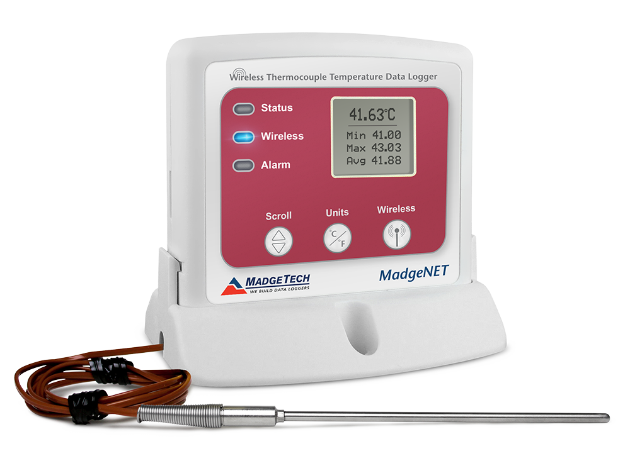

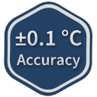
RFTCTemp2000A
Wireless Thermocouple Temperature Monitoring
Features & Benefits
Ideal for Remote Temperature Monitoring with a
Thermocouple & Ambient Temperature Monitoring:
  Measurement Range:
  -20 °C to +60 °C (-4 °F to +140 °F)
Bracket for Wall Mounting:
  Dimensions: 3.0 in x 3.5 in 0.95 in
  (76.2 mm x 88.9 mm x 24.1 mm)
Long Battery Life:
  3 years typical at a 1 minute reading rate
Applications:
Laboratory Monitoring, Warehouse Monitoring, Chemical Storage, Medical & Pharmaceutical, Clean Rooms,
Refrigerators & Freezers

Slide 15
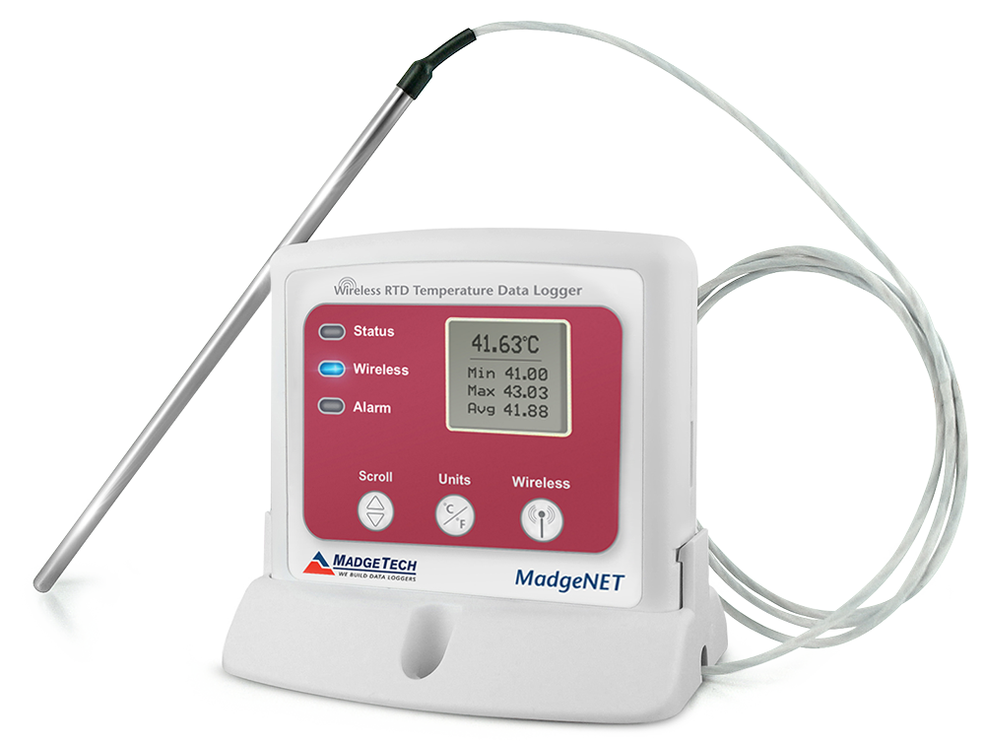
RFRTDTemp2000A
Wireless Precision RTD Temperature Monitoring
Features & Benefits
Ideal for Applications that Require
High Temperature Monitoring:
  External Channel Temperature Range:
  -200 °C to +850 °C (-392 °F to +1562 °F)
Bracket for Wall Mounting:
  Dimensions: 3.0 in x 3.5 in 0.95 in
  (76.2 mm x 88.9 mm x 24.1 mm)
Long Battery Life:
  4 years typical at a 1
  minute reading rate
Applications:
Laboratory & Hospitals, Medical & Pharmaceutical,
Clean Rooms

Slide 16
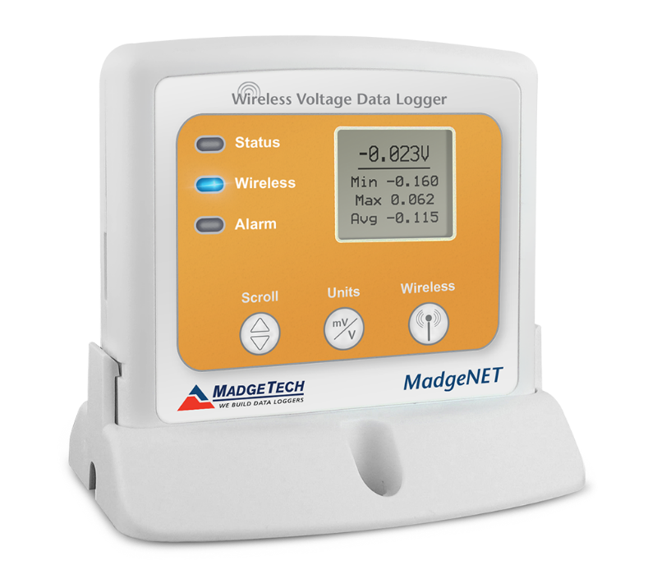
RFVolt2000A
Wireless Voltage Monitoring
Features & Benefits
Ideal for Applications that Require
DC Voltage Signal Monitoring:
  Measurement Range:
  -3 VDC to +3 VDC for 2.5 V
  -8 VDC to +24 VDC for 15 V
  -8 VDC to +32 VDC for 30 V
  -160 mVDC to +160 mVDC for 160 mV
Bracket for Wall Mounting or Stand:
  Dimensions: 3.5 in x 3.17 in 0.95 in
  (88.9 mm x 80.5 mm x 24.1 mm)
Long Battery Life:
  5 years typical at a 15 minute reading rate
Applications:
Battery Usage Studies, Solar Cell Monitoring, Cathodic Protection Monitoring, Applications that Require an External Sensor, 160 mV Model Measures Radio or Electromagnetic Frequency Interference

Slide 17
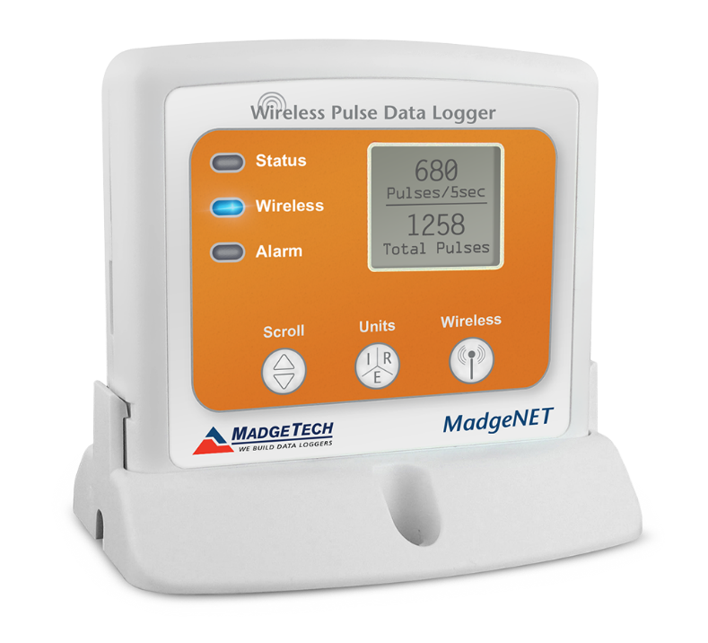
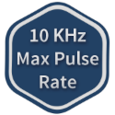
RFPulse2000A
Wireless Pulse Monitoring
Features & Benefits
Ideal for Applications that Require Pulse
Output Signal Monitoring:
  Measurement Range:
  Input Low: <720 mV
  Input High: >1.070 V
Bracket for Wall Mounting or Stand:
  Dimensions: 3.5 in x 3.0 in x 0.95 in
  (88.9 mm x 76.2 mm x 24.1 mm)
Long Battery Life:
  5 years typical at a 10 minute reading rate
Applications:
Wind Speed Monitoring, Energy Monitoring,
Flow Rate Monitoring

Slide 18
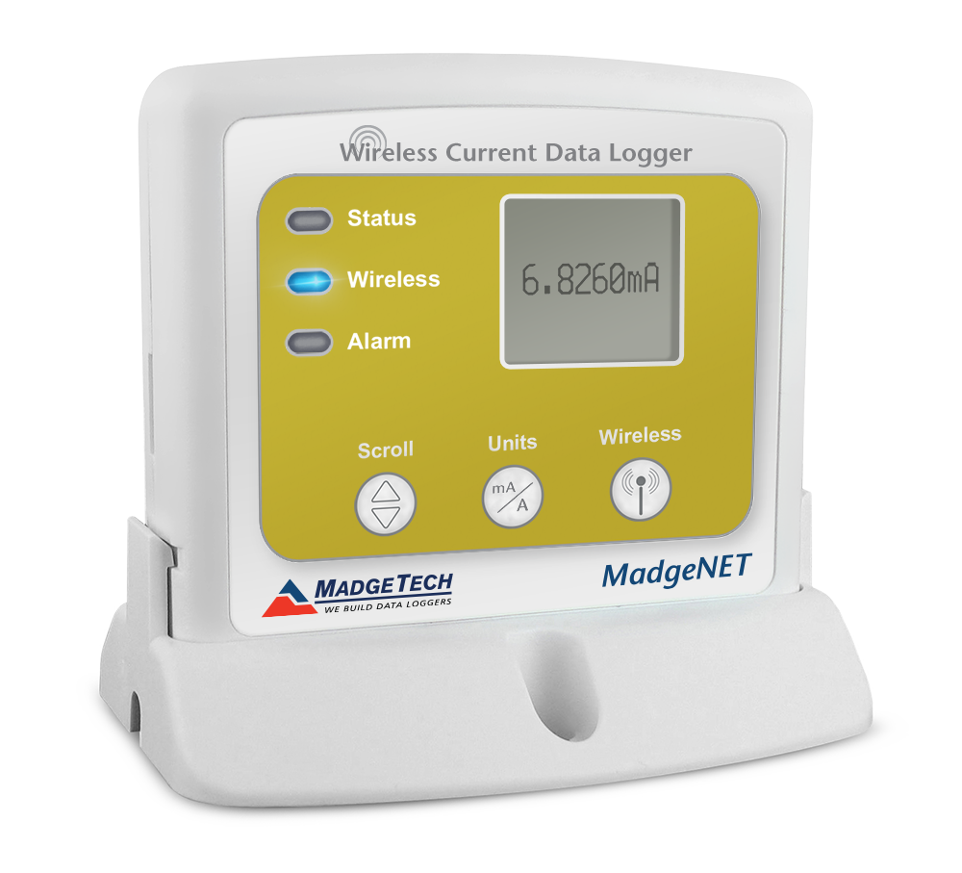


RFCurrent2000A
Wireless DC Current Monitoring
Features & Benefits
Ideal for Applications that Require
DC Current Signal Monitoring:
  Nominal Range:
  20 mA, 160 mA & 3 A
Bracket for Wall Mounting or Stand:
  Dimensions for 20 mA & 3 A: 3.19 in x 3.5 in x 0.95 in
  (80.9 mm x 88.9 mm x 24.1 mm) - Data logger only
  Dimensions for 160 mA: 3.17 in x 3.5 in x 0.95 in
  (80.5 mm x 88.9 mm x 24.1 mm) - Data logger only
Long Battery Life:
  4 years typical at a 15 minute reading rate
Applications:
Battery Usage Studies, Energy Monitoring Studies, Photovoltaic Research (PV), Process Control Instrument Recording, Data Logging from Sensors with Current Outputs
For the 20 mA &
160 mA models
For the 3 A model

Slide 19
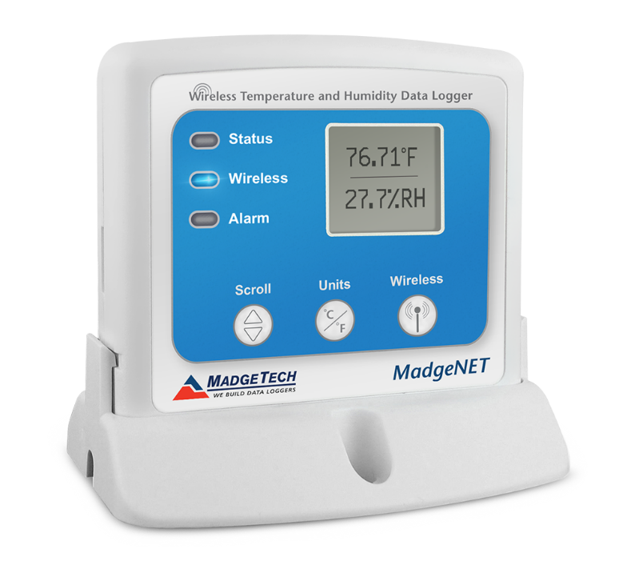
RFRHTemp2000A
Wireless Humidity & Temperature Monitoring
Features & Benefits
Ideal for Industrial or Laboratory Applications.
Designed with External Humidity and
RTD Temperature Sensors:
  Measurement Range:
  -20 °C to +60 °C (-4 °F to +140 °F),
  0 %RH to 95 %RH
Bracket for Wall Mounting or Stand:
  Dimensions: 3.0 in x 3.5 in 0.95 in
  (76.2 mm x 88.9 mm x 24.1 mm)
Long Battery Life:
  3 years typical at a 1 minute reading rate
Applications:
Laboratory Monitoring, Warehouse Monitoring, Incubators, Chemical Storage, Clean Rooms, Greenhouse Monitoring

Slide 20
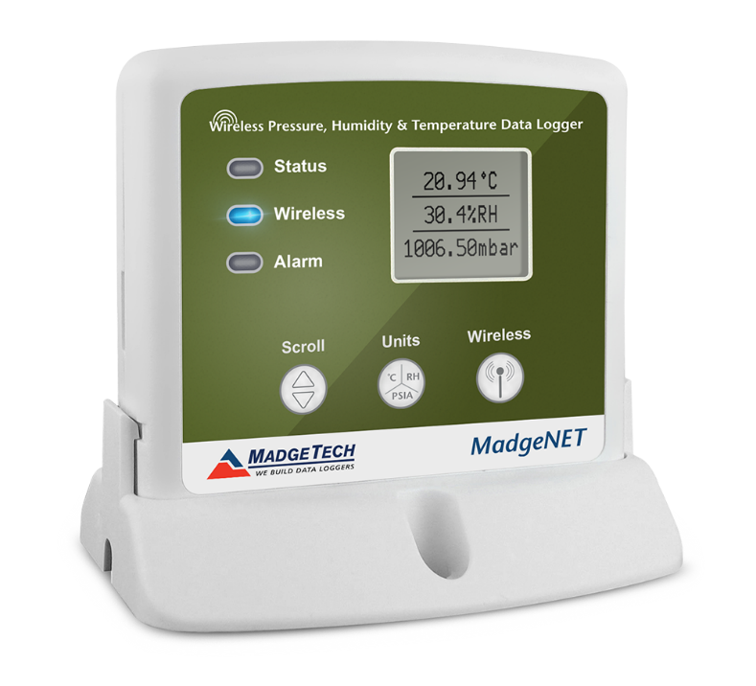

RFPRHTemp2000A
Wireless Pressure, Humidity & Temperature Monitoring
Features & Benefits
Ideal for Applications that Require Ambient
Pressure, Humidity & Temperature Monitoring:
  Measurement Range:
  -20 °C to +60 °C (-4 °F to +140 °F)
  0 %RH to 95 %RH, 250 mbar to 1300 mbar
Bracket for Wall Mounting or Stand:
  Dimensions: 3.5 in x 3.0 in x 0.95 in
  (88.9 mm x 76.2 mm x 24.1 mm)
Long Battery Life:
  5 years typical at a 15 minute reading rate
Applications:
Weather Data Monitoring, Warehouse Monitoring, Clean Rooms, Measuring Barometric Pressure in High Rise Buildings

Slide 21
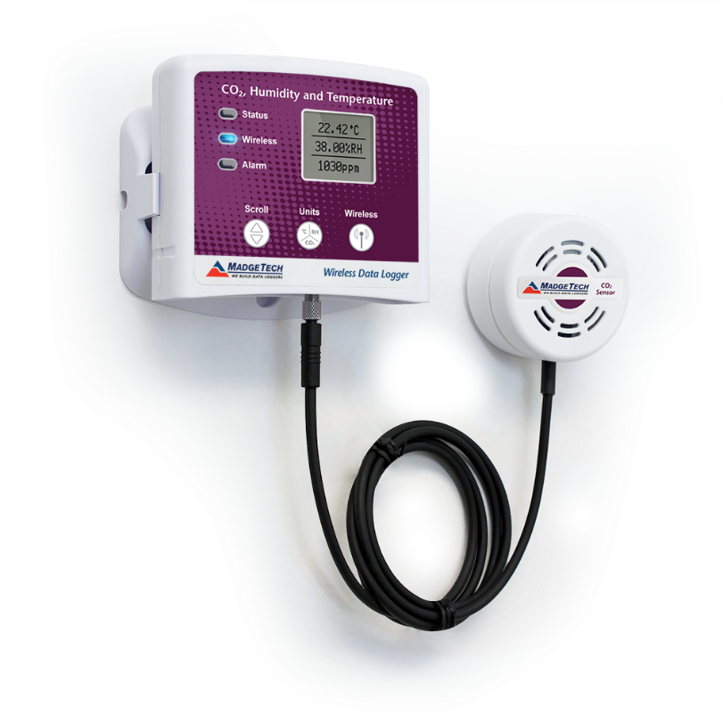
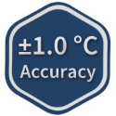
RFCO2RHTemp2000A
Wireless Pressure, Humidity & Temperature Monitoring
Features & Benefits
Ideal for Air Quality Study Applications like
HVAC and more. Designed with External CO2,
Humidity & Temperature Sensor:
  Measurement Range:
  0 °C to +55 °C (-32 °F to +131 °F)
  0 %RH to 95 %RH non-condensing,
  0.002 to 100 PSIA
Bracket for Wall Mounting:
  Dimensions: 3.5 in x 3.25 in 0.95 in
  (88.9 mm x 82.6 mm x 24.1 mm)
Battery Life:
  16 months typical at a 10 minute reading rate
Applications:
Incubator Monitoring, Building Studies (hospitals, schools, offices), HVAC System Testing, Agricultural Studies, Indoor Air Quality (IAQ) Studies

Slide 22
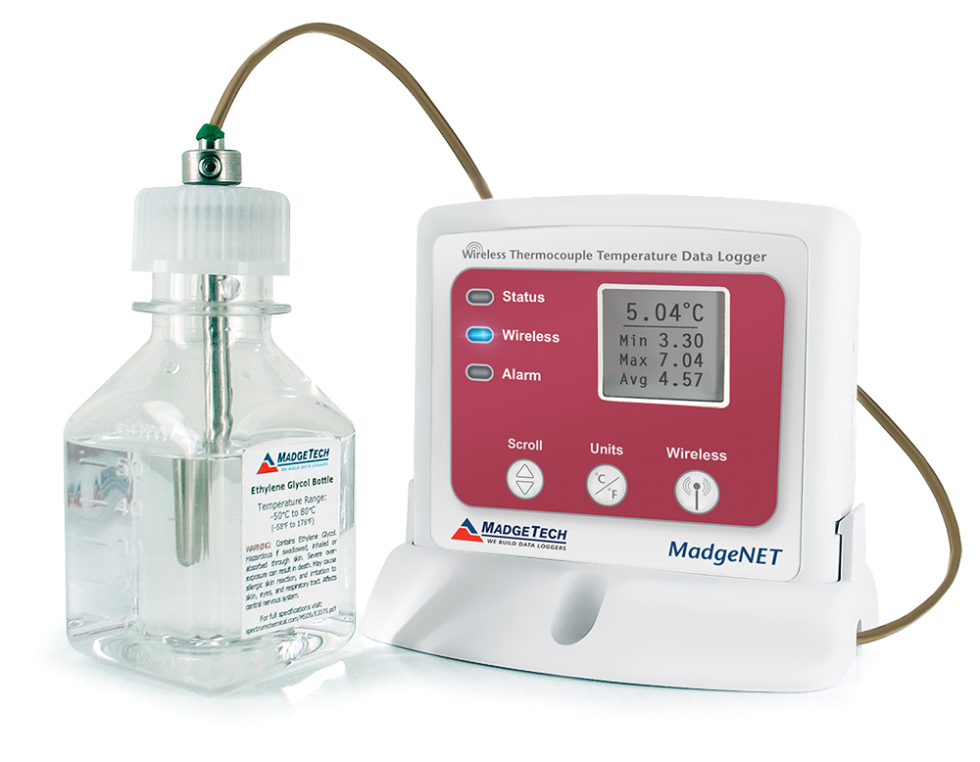
VTMS
Wireless Vaccine Temperature Monitoring System
Features & Benefits
Ideal for Applications that Require
Continual Temperature Sensitive Monitoring:
  Type K Thermocouple (Included)
Operating Environment:
  -20 °C to +60 °C (-4 °F to +140 °F)
  0 %RH to 95 %RH non-condensing
Bracket for Wall Mounting:
  Dimensions: 3.0 in x 3.5 in x 0.95 in
  (76.2 mm x 88.9 mm x 24.1 mm)
Long Battery Life:
  3 years typical at a 1 minute reading rate
Applications:
Incubator Monitoring, Building Studies (hospitals, schools, offices), HVAC System Testing, Agricultural Studies, Indoor Air Quality (IAQ) Studies

Slide 23
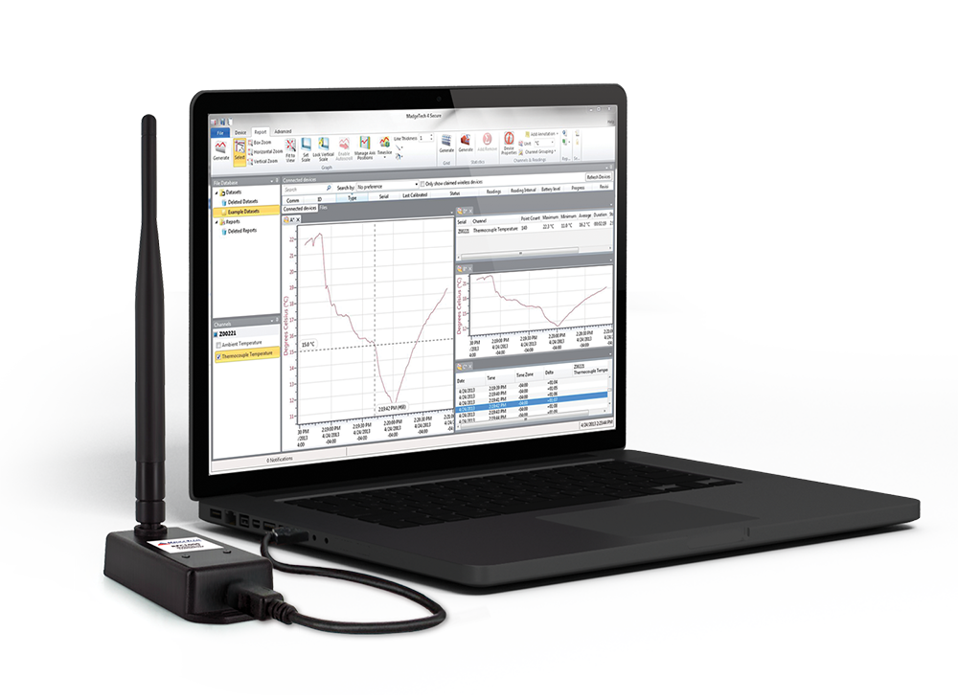
RFC1000
Wireless Transceiver & Repeater
Features & Benefits
Wireless transceiver & repeater for
wireless data loggers.
Long transmission range, for better
performance in occluded environments
such as ovens & refrigerators.
Includes external antenna, allowing more
flexibility with mounting positions in both
orientation & proximity to *metal walls.
Transmission distance to other RFC1000’s:
  4,000 ft outdoor (line of sight unobstructed)
  1000 ft indoor (line of sight unobstructed)
Transmission distance to data loggers:
  2,000 ft outdoor (line of sight unobstructed)
  500 ft indoor (line of sight unobstructed)
*Note: The RFC1000 has to be 6-12 inches way from
metal beams for less obstruction of signal.

Slide 24

RFC1000-CE
Wireless Transceiver & Repeater, CE Approved for Europe
Features & Benefits
Wireless transceiver & repeater for
wireless data loggers.
Long transmission range, for better
performance in occluded environments
such as ovens & refrigerators.
Includes external antenna, allowing more
flexibility with mounting positions in both
orientation & proximity to *metal walls.
Transmission distance to other RFC1000-CE’s:
  2,500 ft outdoor (line of sight unobstructed)
  700 ft indoor (line of sight unobstructed)
Transmission distance to data loggers:
  2,000 ft outdoor (line of sight unobstructed)
  500 ft indoor (line of sight unobstructed)
*Note: The RFC1000-CE has to be 6-12 inches way from
metal beams for less obstruction of signal.

Slide 25

RFC1000-IP69K
Splash Proof Wireless Transceiver & Repeater
Features & Benefits
Splash Proof Wireless transceiver & repeater
for wireless data loggers.
Long transmission range, for better
performance in occluded environments
such as ovens & refrigerators.
Includes external antenna, allowing more
flexibility with mounting positions in both
orientation & proximity to *metal walls.
Transmission distance to other RFC1000-IP69K’s:
  4,000 ft outdoor (line of sight unobstructed)
  1000 ft indoor (line of sight unobstructed)
Transmission distance to data loggers:
  2,000 ft outdoor (line of sight unobstructed)
  500 ft indoor (line of sight unobstructed)
*Note: The RFC1000-IP69K has to be 6-12 inches way from
metal beams for less obstruction of signal.

Slide 26

MadgeTech Cloud Services

Slide 27


MadgeTech Cloud Services
Features of the MadgeTech Cloud

Slide 28

MadgeTech Cloud Services
Features of the MadgeTech Cloud
The MadgeTech Cloud Hosted data logging platform provides continuous logging and monitoring of temperature, pressure, and humidity data while giving users instant access for from any location.
With MadgeTech Cloud Services, data loggers can securely transmit data in real time to be viewed on any internet or data enabled device such as a computer, tablet, or cell phone.

Slide 29

MadgeTech Cloud Services
Features of the MadgeTech Cloud
Scalable Solution with Limitless Applications
Quick & Easy Setup
Monitoring & Logging Continuously
Access Data Instantly & Securely from Anywhere in the World
Email & Text Message Alarm Notifications
Audit Alarm Activity Response
Powerful Customizable User Interface
Data Dashboard Overview
Roles & Users
  Standard
  Advanced
  Administrative
World Class Support

Slide 30
MadgeTech 4 Data Logger Software

Slide 31

Data Logger Software
MadgeTech 4 Software
Powerful Data Analysis
Customizable Reports:
  Graph
  Tabular Data
  Reports
Annotate data points on the graph or tabular data.
Statistics include minimum, maximum, average,
time above temperature & more.
User Friendly
Immediate device status information
Digital calibration
Automatic data saving
Export to Excel®

Slide 32

Getting Started
Communication
All wireless loggers will automatically be identified by the software and displayed in the
Connected Devices panel.
Multiple devices can be connected, configured and operated simultaneously.
Information for each device is displayed in the main screen including Device ID, Serial Number,
Last Calibration Date and the Battery Level.

Slide 33

Initial Setup
Claiming a Wireless Data Logger
Claiming the Data Logger
To claim a 2000A data logger, find the device within the Connected Devices panel.
Click to highlight and then click the Claim icon.
Wireless loggers only need to be claimed to the PC once.
Claiming a logger associates it with the PC. This is particularly useful in facilities with multiple data
logger networks.
Once a data logger is claimed, additional information can be viewed in the Connected Devices panel.
If a device is “unclaimed” the text will be greyed out.

Slide 34



Start In Real Time
Starting a 2000A Data Logger & Viewing Data in Real Time
1
2
3
To start a 2000A data logger in real time, select a device within the Connected Devices panel.
Select Real Time Start from the Control tab in the top menu bar.
Choose your parameters for reading rate, immediate or delay start.

Slide 35



Data Analysis
Data Handling & File Database
As data is transmitted, it is automatically saved to the built-in file database within the software for automatic storage.
Downloaded data will be saved and accessible in the Datasets folder.
When in Real Time mode, a graph will automatically be generated and displayed from the transmitted data.
Customized graphs and compiled data can be saved to the Reports Folder.
The look and feel is comparable to standard email programs to aid in user friendliness and ease of use.
Data from multiple devices can be dragged into a single composite graph. Displayed channels can be controlled via the Channels column.

Slide 36



Data Analysis
Graphs, Statistics & Tabular Data
Tabular Data
Graph
Statistics

Slide 37


Data Analysis
Customizable Interface
1
2
Layout 1
Layout 2
To increase efficiency, the MadgeTech software allows users to customize the layout of the screen multiple ways to better suit their needs.

Slide 38

Data Analysis
Statistics
A0
Average
Change per Second
Delta (First/Last)
Delta (Min/Max)
Duration
F0
Gain/Loss
Maximum
Mean Kinetic Temperature
Median
Minimum
Mode
Pasteurization
Point Count
Relative Standard Deviation
Standard Deviation
Sum
Time Above Threshold
Time Below Threshold
Time to 66%

Slide 39


Data Analysis
Timeslice
The Timeslice feature enables users to
view statistics for
user-selectable
sections of data.
Statistics report will update and recalculate based on the Timeslice selection.

Slide 40


Wireless Alarming
Create a Variety of Device Alarms
1
2
User-programmable alarms
Real time wireless notifications
Alarms available for all measured parameters
Audible, on screen, email and text message options

Slide 41


Export to Excel
Export with the click of a button
MadgeTech Software makes data review easy with the ability to export to Microsoft Excel®.

Slide 42
Servicing and Maintenance

Slide 43


Calibration & Maintenance
Data Logger Efficiency
Annual recalibration is recommended.
Professional calibration services are offered by
MadgeTech for all data loggers.
Traceable to NIST for temperature, relative humidity,
pressure, current, pH, bridge/strain & voltage.
Standard servicing plans include:
  Free device evaluation
  As Found data collection
  Battery replacement
  Calibration and adjustment at
  standard points
Custom calibration options available

Slide 44




Calibration & Maintenance
Data Logger Efficiency
Certificate header displays details specific to the calibration being performed and
the DUT information such as the Device ID and Model.
Calibration section lists device specifications and calibration results.
The As Found and As Left section displays data side by side for quick and easy identification.
The Issued By and Approved By signatures stand up to auditor scrutiny.
Calibration Reference Equipment information is always listed. Full calibration certificates are available upon request.
Device ID & Model
As Found & As Left
Issued and Approved By

Slide 45


MadgeTech Servicing
Calibration Equipment
Test Equipment
(2) PGC Temperature and humidity stability chambers
Various circulating baths
Reference Equipment
Fluke Calibration 1502A Thermometer Readouts
  Accuracy of: 0.030 °C, -80.00 °C to +300.00 °C
Test and Reference Equipment Subject to:
Annual Calibration
Annual Validation
Annual Mapping

Slide 46
Data Security
The assurance of data retrieval
MadgeTech wireless systems ensure
data is saved as a backup in each
step of the process.
Data is automatically stored to internal memory local to the data logger.
Each data logger has a 250 reading wireless buffer. If communications are interrupted in any way, readings will be stored to a memory buffer and will automatically be transmitted once communications are reestablished.
Data is automatically saved to the File Database once transmitted.
Alarm log provides a historical record
of alarm breaches.

Slide 47


MadgeTech Customer Support
MadgeTech data loggers come with a one year manufacturers warranty.
Free support available for the lifetime of the product.
Contact Information:
Phone: 603-456-2011
Fax: 603-456-2012
Email: info@madgetech.com

